Slide 1


Adeoti Rasheed Moyosore January, 2024

Slide 2

Outline
Executive Summary
Introduction
Methodology
Results
Conclusion
Appendix

Slide 3
Executive Summary
SUMMARY OF METHODOLOGIES
Data Collection through API
Data Collection with Web Scraping
Data Wrangling
Exploratory Data Analysis with SQL
Exploratory Data Analysis with Data Visualization
Interactive Visual Analytics with Folium
Machine Learning Prediction
SUMMARY OF ALL RESULTS
Exploratory Data Analysis result
Interactive analytics in screenshots
Predictive Analytics result

Slide 4
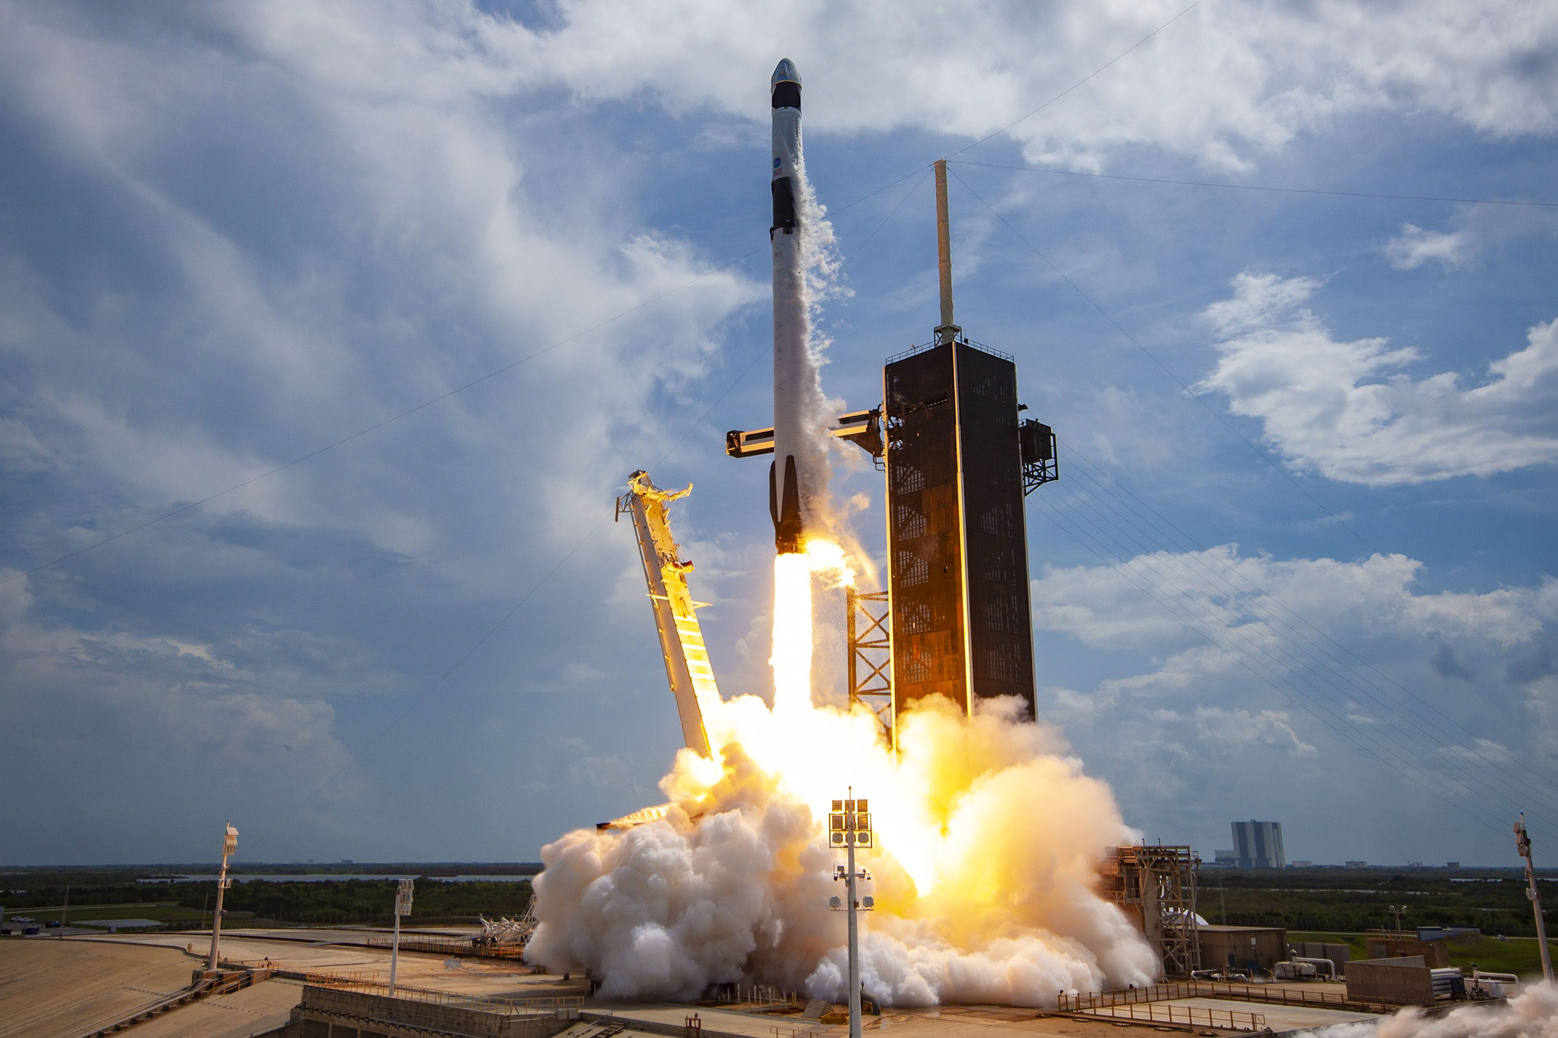
Introduction
The aerospace industry features a pronounced cost differential in rocket launches, exemplified by SpaceX's Falcon 9 priced at $62 million, significantly lower than competitors demanding over $165 million.
A pivotal factor in SpaceX's cost-effectiveness is its groundbreaking approach to reuse the Falcon 9's first stage. Accurate prediction of the first stage's successful landing is instrumental in determining the overall launch cost. This insight holds strategic significance for companies competing against SpaceX for rocket launch contracts, allowing them to position strategically and enhance decision-making. Understanding the cost-saving potential of first-stage reusability not only deepens financial comprehension but also provides a crucial competitive edge in a sector emphasizing innovation and efficiency.

Slide 5

Section 1

Slide 6
Methodology
Executive Summary
Data collection methodology:
Data was collected using SpaceX API and web scraping from Wikipedia.
Perform data wrangling
One-hot encoding was applied to categorical features
The class label was encoded into numerical feature
Perform exploratory data analysis (EDA) using visualization and SQL
Perform interactive visual analytics using Folium and Plotly Dash
Perform predictive analysis using classification models
Build a Machine Learning Models to predict if the first stage lands successfully

Slide 7

Data Collection
The analysis utilized data obtained through various collection methods. Initial data collection involved making GET requests to the Space X API, followed by decoding the responses into JSON files. Subsequently, these JSON files were transformed into a pandas data frame. The dataset was then filtered to exclusively include Falcon 9 launches. Once the data was filtered, we proceeded to clean it by identifying and replacing missing values.
Additionally, we conducted web scraping on Wikipedia using Beautiful Soup specifically for Falcon 9 launches. A data frame was created by parsing the HTML tables obtained through this web scraping process.

Slide 8
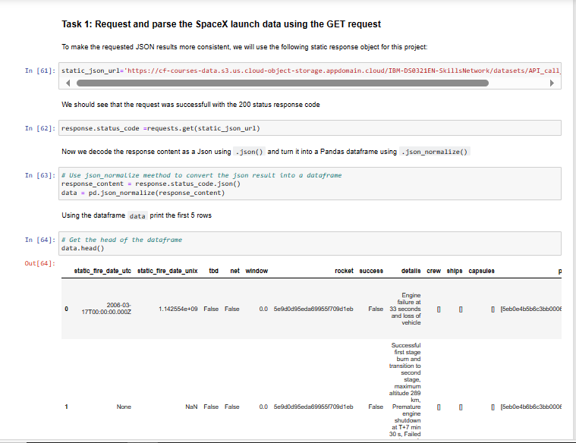
Data Collection – SpaceX API
We obtained the necessary data for the analysis by employing the GET request method through the Space X API. Subsequently, we engaged in data wrangling and formatting to prepare the data for the analysis.
The Link to the notebook is; https://github.com/Moyosore121/IBM-DATA-SCIENCE-CAPSTONE-PROJECT-/blob/main/Data%20Collection%20using%20API.ipynb

Slide 9
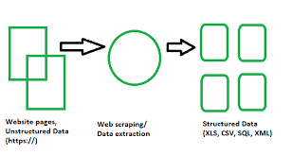
Data Collection - Scraping
We initiated a request to the Falcon 9 launch HTML page to obtain an HTTP response. After receiving the response, we extracted its content. Following that, we parsed the content using Beautiful Soup, extracting the essential tables and columns needed for the analysis. Finally, we saved the extracted data into a CSV file.
The Link to the notebook is; https://github.com/Moyosore121/IBM-DATA-SCIENCE-CAPSTONE-PROJECT-/blob/main/DATA%20COLLECTION%20WEBSCRAPPING%20.ipynb

Slide 10
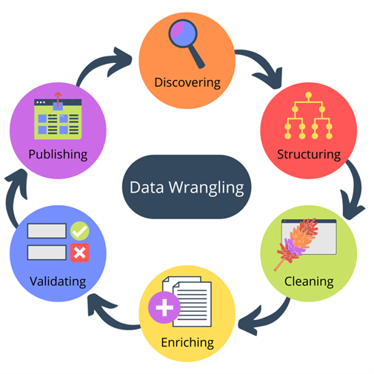
Data Wrangling
Upon extracting the data, we loaded it into a data frame for exploratory data analysis. Initially, we examined the data types of each column in the dataset. Subsequently, we investigated the number of launches at each site, identifying CCAFS SLC 40 as the site with the highest launches. We then explored the frequency of each orbit and proceeded to create a landing outcome label for the landing column. This analytical process familiarized us thoroughly with the dataset.
The Link to the notebook is; https://github.com/Moyosore121/IBM-DATA-SCIENCE-CAPSTONE-PROJECT-/blob/main/Data%20Wrangling.ipynb

Slide 11
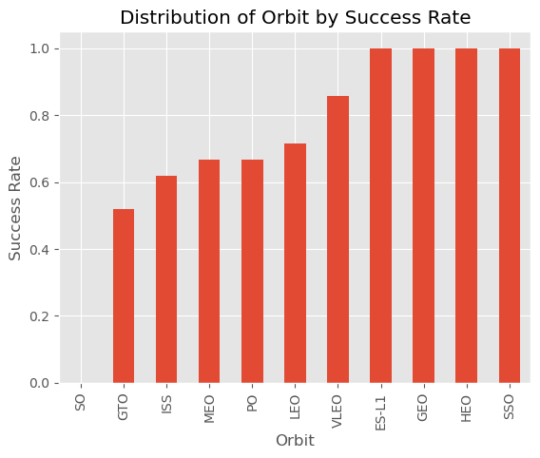
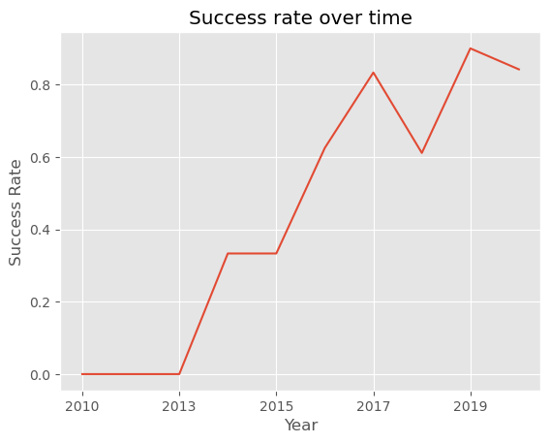
EDA with Data Visualization
During the exploratory data analysis through visualization, we examined the relationships between different features in the dataset. Our initial focus was on visualizing the correlation between Flight Number and Launch Site, revealing that CCAFS SLC 40 exhibited the highest number of successful launches. We proceeded to explore the connection between Payload and Launch Site, uncovering that for the VAFB-SLC launch site, no rockets were launched for heavy payload masses (greater than 10000).
Next, we investigated the relationship between the success rate of each orbit type, gaining insights into orbits with high success rates. Finally, we visualized the annual trend of launch success to identify years with a high success rate, aiming to discern any patterns in those particular years. The Link to the notebook is; https://github.com/Moyosore121/IBM-DATA-SCIENCE-CAPSTONE-PROJECT-/blob/main/Exploratory%20Data%20using%20Data%20Visualization%20%20.ipynb

Slide 12
EDA with SQL
We loaded the SpaceX dataset into a PostgreSQL database without leaving the jupyter notebook.
We applied EDA with SQL to get insight from the data. We wrote queries to find out for instance:
The names of unique launch sites in the space mission.
The total payload mass carried by boosters launched by NASA (CRS)
The average payload mass carried by booster version F9 v1.1
The total number of successful and failure mission outcomes
The failed landing outcomes in drone ship, their booster version and launch site names.
The link to the notebook is: https://github.com/Moyosore121/IBM-DATA-SCIENCE-CAPSTONE-PROJECT-/blob/main/Exploratory%20Data%20Analysis%20with%20SQL.ipynb

Slide 13
Build an Interactive Map with Folium
We marked all launch sites, and added map objects such as markers, circles, lines to mark the success or failure of launches for each site on the folium map.
We assigned the feature launch outcomes (failure or success) to class 0 and 1.i.e., 0 for failure, and 1 for success.
Using the color-labeled marker clusters, we identified which launch sites have relatively high success rate.
We calculated the distances between a launch site to its proximities. We answered some question for instance:
Are launch sites near railways, highways and coastlines.
Do launch sites keep certain distance away from cities.

Slide 14
Build a Dashboard with Plotly Dash
We built an interactive dashboard with Plotly dash
We plotted pie charts showing the total launches by a certain sites
We plotted scatter graph showing the relationship with Outcome and Payload Mass (Kg) for the different booster version.
The link to the notebook is: https://github.com/Moyosore121/IBM-DATA-SCIENCE-CAPSTONE-PROJECT-/blob/main/Launch%20Sites%20Locations%20Analysis%20with%20Folium.ipynb

Slide 15
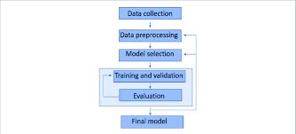
Predictive Analysis (Classification)
A machine learning classification model was developed to predict the success of the first stage landing. The process unfolded by importing all the necessary libraries required for model creation. Subsequently, the data was split into the feature matrix and target vector. Standard scaling was applied to both the feature matrix and target vector using the Standard Scalar. The data was further divided into training and testing sets using the train-test split function in Scikit-learn.
Next, five different machine learning models were trained on the training dataset utilizing Grid Search Cross-validation to determine the best hyper-parameters. The models included Logistic Regression, Decision Tree Classifier, Support Vector Machine, and K-Neighbors Classifier. The model performance was then assessed using the test dataset. Remarkably, the models exhibited excellent performance, achieving an accuracy score of over 80% on the test data. The link to the notebook is https://github.com/Moyosore121/IBM-DATA-SCIENCE-CAPSTONE-PROJECT-/blob/main/Space%20X%20%20Falcon%209%20First%20Stage%20Landing%20Prediction.ipynb

Slide 16
Results
Exploratory data analysis results
Interactive analytics demo in screenshots
Predictive analysis results

Slide 17

Section 2

Slide 18
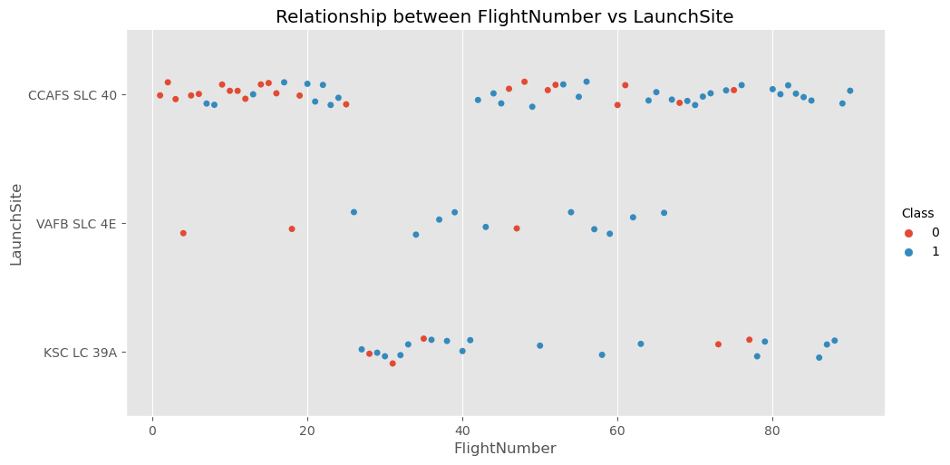
KSC LC 39A
Flight Number vs. Launch Site
There is a positive correlation between flight number and launch site.
CCAFS SLC 40 is the most common launch site for the flights in the dataset.
KSC LC 39A is the least common launch site for the flights in the dataset.
VAFB SLC 4E has the highest success rate with a success rate of 78%

Slide 19
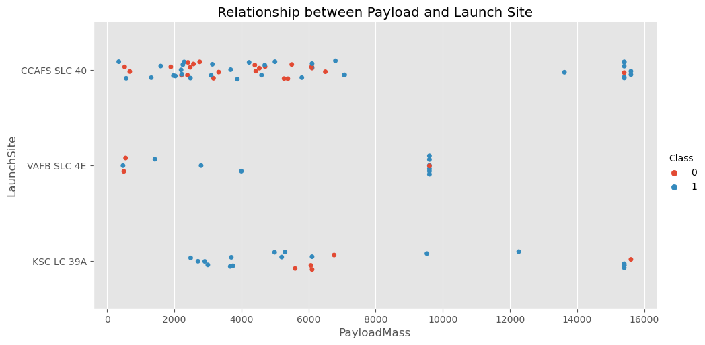
Payload vs. Launch Site
For the VAFB-SLC launch site there are no rockets launched for heavy payload mass(greater than 10000).
Most of the launch in the KSC LC 39A launch site below a payload mass of 5000 where successful.
Most of the launch in the CCAFS SLC 40 launch site above a mass of 14000 were successful

Slide 20
Success Rate vs. Orbit Type
From the plot, we can see that ES-L1, GEO, HEO, SSO, VLEO had the most success rate.
The orbit SO had a 0% success rate

Slide 21
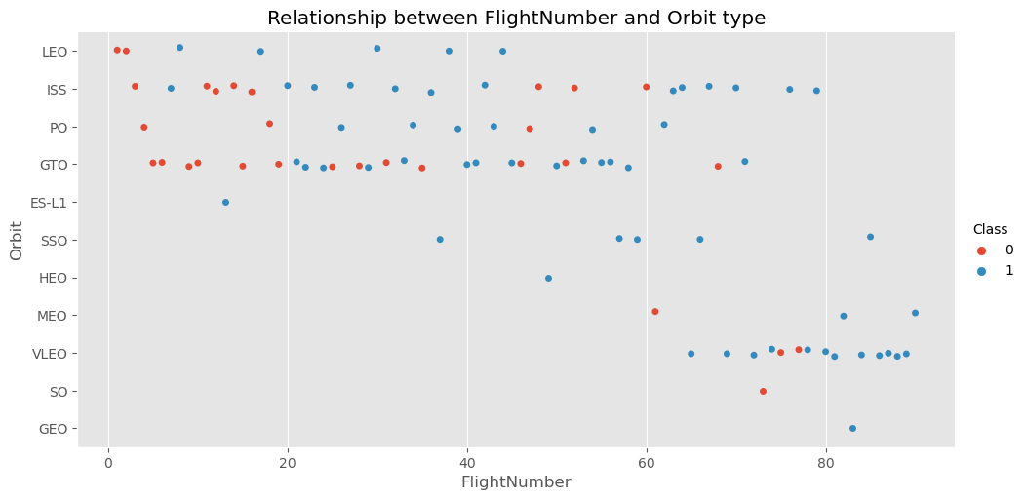
Flight Number vs. Orbit Type
The LEO orbit the Success appears related to the number of flights.
There is no relationship between flight number when in GTO orbit.

Slide 22
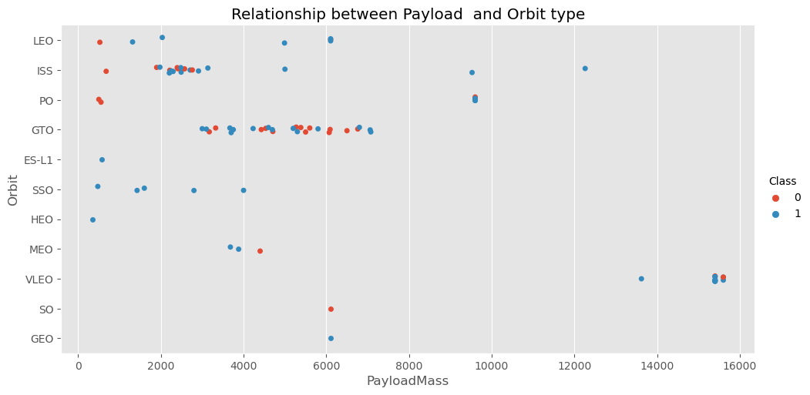
Payload vs. Orbit Type
With heavy payloads the successful landing or positive landing rate are more for Polar, LEO and ISS.

Slide 23
Launch Success Yearly Trend
The success rate since 2013 kept increasing till 2017 (stable in 2014) and after 2015 it started increasing and it came down a little bit in 2017 and then went back up in 2018.

Slide 24

All Launch Site Names
We used the key word DISTINCT to show only unique launch sites from the SpaceX data.

Slide 25

Launch Site Names Begin with 'CCA'
We selected all the rows from the Space X table where launch site looks likes “CCA”

Slide 26

Total Payload Mass
We calculated the total payload carried by boosters from NASA as 45596 using the query below.

Slide 27

Average Payload Mass by F9 v1.1
We calculated the average payload mass carried as 2928.4 using the code below.

Slide 28

First Successful Ground Landing Date
We observed that the dates of the first successful landing outcome on ground pad was 22nd December 2015.

Slide 29

Successful Drone Ship Landing with Payload between 4000 and 6000
We used the WHERE clause to filter for boosters which have successfully landed on drone ship and applied the AND condition to determine successful landing with payload mass greater than 4000 but less than 6000

Slide 30

Total Number of Successful and Failure Mission Outcomes
We used wildcard like ‘%’ to filter for WHERE Mission Outcome was a success or a failure.

Slide 31

Boosters Carried Maximum Payload
We determined the booster that have carried the maximum payload using a sub query in the WHERE clause and the MAX() function.

Slide 32

2015 Launch Records
We used a combinations of the WHERE clause, LIKE, AND, and BETWEEN conditions to filter for failed landing outcomes in drone ship, their booster versions, and launch site names for year 2015

Slide 33

Rank Landing Outcomes Between 2010-06-04 and 2017-03-20
We selected Landing outcomes and the COUNT of landing outcomes from the data and used the WHERE clause to filter for landing outcomes BETWEEN 2010-06-04 to 2010-03-20.
We applied the GROUP BY clause to group the landing outcomes and the ORDER BY clause to order the grouped landing outcome in descending order.

Slide 34

Section 3

Slide 35
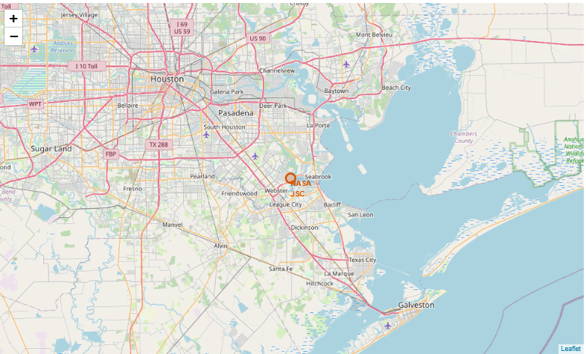
ALL LAUNCH SITES GLOBAL MAP MARKERS

Slide 36
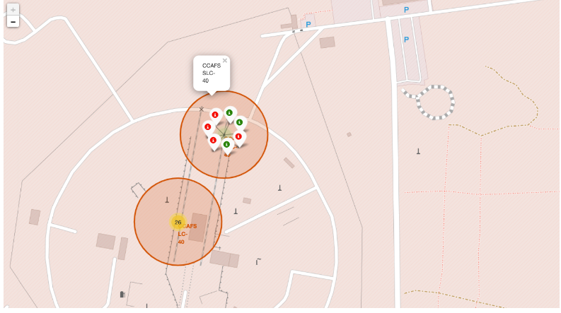
Markers showing launch sites with color labels

Slide 37
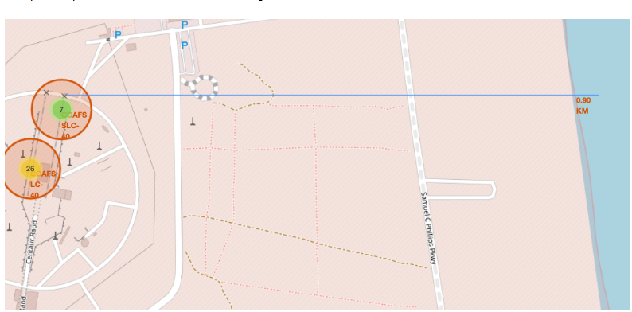
Launch Site distance to landmarks

Slide 38

Section 4

Slide 39

Pie chart showing the success percentage achieved by each launch site

Slide 40

Pie chart showing the Launch site with the highest launch success ratio

Slide 41

Scatter plot of Payload vs Launch Outcome for all sites, with different payload selected in the range slider

Slide 42

Section 5

Slide 43
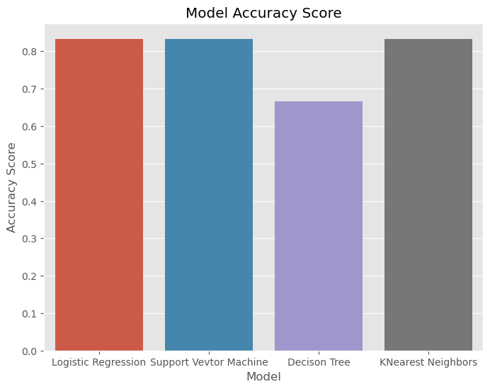
Classification Accuracy
The K-Nearest Neighbors model performed best on the test data.

Slide 44
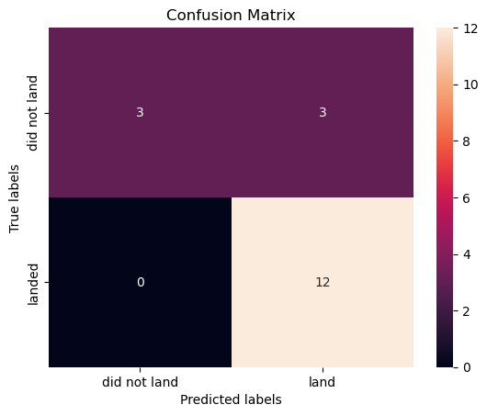
Confusion Matrix
Accuracy: 83.3%; This signifies a good overall performance, correctly classifying over 80% of the cases.
Precision: = 80%; This means that 80% of the predicted positives were actually positive, indicating good model precision for the positive class.
Recall (Sensitivity): 100%; This indicates perfect recall for the positive class, meaning the model identified all true positives without missing any.

Slide 45
Conclusions
The launch site known as “KSC LC-39A" boasts a commendable track record of successful launches, making it a reliable indicator of whether a Falcon will land successfully.
The launch site referred to as "KSC LC 39A" is a reliable predictor of a Falcon's successful landing, particularly when the payload mass is below 5000kg.
The orbits labeled "ES-L1," "GEO," "HEO," "SSO," and "VLEO" exhibit a high success rate, making them reliable indicators of whether a Falcon will land successfully
The Falcon demonstrates a notably high success rate when handling a lightweight payload, establishing it as a reliable indicator for predicting a successful landing.
We successfully developed a machine learning model for classification that can predict whether a Falcon will land with an accuracy approaching 85%.

Slide 46
Appendix
https://github.com/Moyosore121/IBM-DATA-SCIENCE-CAPSTONE-PROJECT-/blob/main/Spacex.csv
https://github.com/Moyosore121/IBM-DATA-SCIENCE-CAPSTONE-PROJECT-/blob/main/dataset_part_1.csv
https://github.com/Moyosore121/IBM-DATA-SCIENCE-CAPSTONE-PROJECT-/blob/main/dataset_part_2.csv
https://github.com/Moyosore121/IBM-DATA-SCIENCE-CAPSTONE-PROJECT-/blob/main/Spacex.csv

Slide 47


